Slide 1
AT&T Spam Detector
by Serdar CEKINMEZ
serdarcekinmez@gmail.com
https://github.com/serdarcekinmez

Slide 2
In this project, we have a dataset of message sentences, and our goal is to identify which SMS messages are spam and which ones are real conversations from AT&T telecommunication company. Our model will consist of several parts:
Division of the dataset into spam and ham messages, creating separate corpora for each category (spam and ham and grand corpus).
Utilization of TFBertForSequenceClassification, a training model for text classification, with the training data converted to lowercase.
Storage of prediction logits, which are the non-normalized prediction values. Softmax is applied to these logits, resulting in non-negative predictions that sum up to 1.

Slide 3
Generale Lines of Spam Detector
FREE message CALL urgent GUARANTEED valid 12hrs
No Data Cleaning: Because spam messages may contain special characters , digits , telephone numbers etc… We store original messages.
Tokenized by BertTokenizer
Seperating the dataset in ham and spam corpus. Visualisations and detecting the spam words on Wordcloud
optimizer
Adam(learning_rate=2e-5, epsilon=1e-08)
loss SparseCategoricalCrossentropy(from_logits=True)
metric SparseCategoricalAccuracy('accuracy')
logits
non-normalized predictions
probabilities
tf.nn.softmax
transformers library from Hugging Face, provided us a base model:
TFBertForSequenceClassification this is a smaller but faster model of BERT
#bert-base-uncased smaller version of the base BERT model,
#trained on uncased (lowercased) English text
#has 12 Transformer layers, 12 attention heads, and 110 million parameters

Slide 4
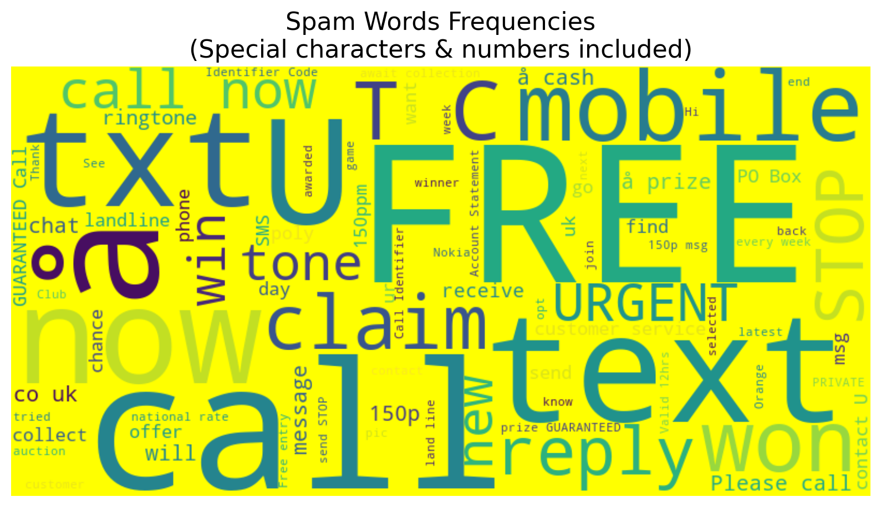

Slide 5
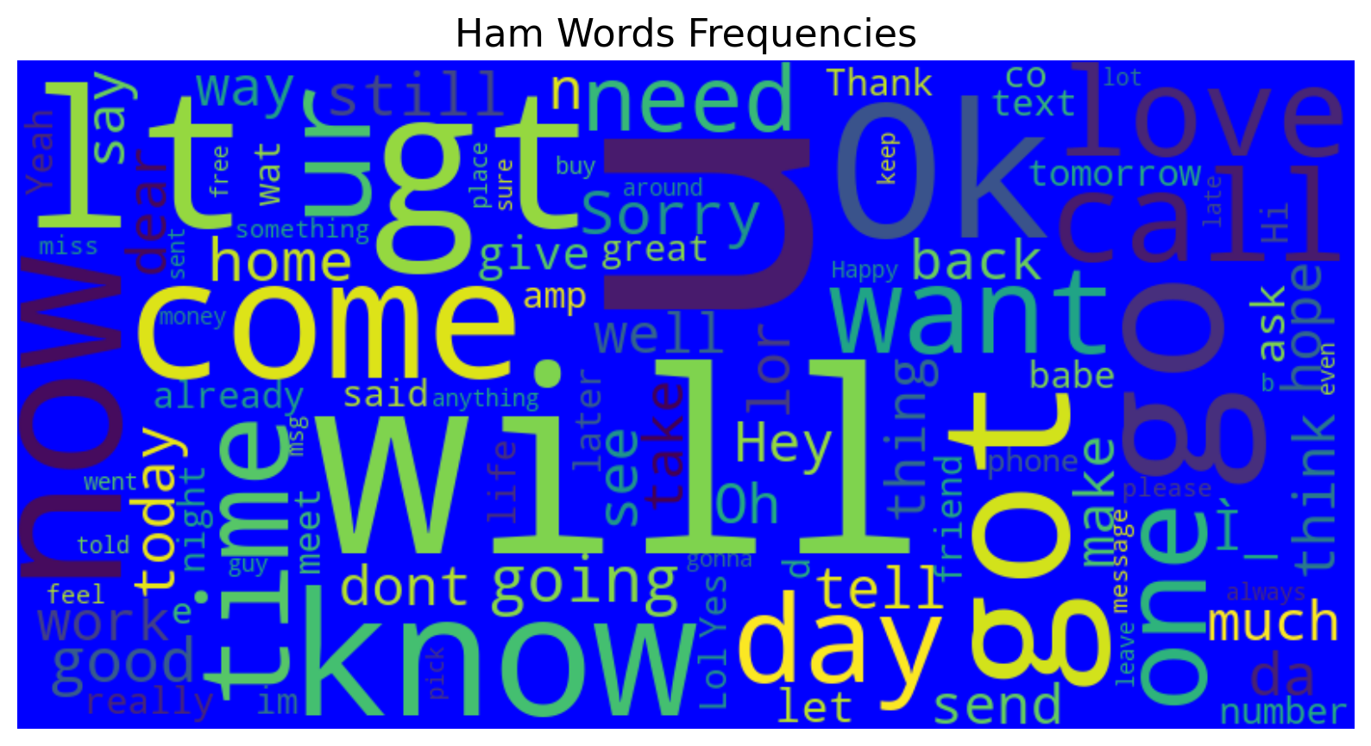

Slide 6
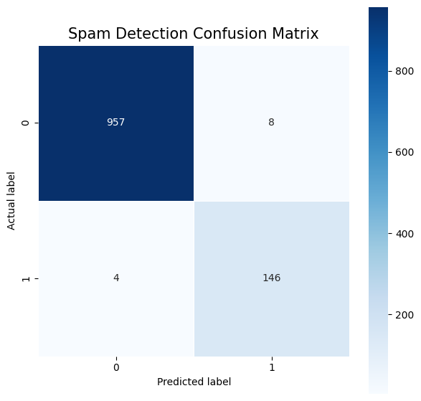
Spam Confusion Matrix
The confusion matrix for your spam detection model reveals its performance in distinguishing spam (label 1) from non-spam (label 0) messages. The matrix shows that the model accurately identified 957 true non-spam messages and 146 true spam messages. However, it mistakenly classified 8 non-spam messages as spam and 4 spam messages as non-spam. Overall, the model has demonstrated a high degree of accuracy

Slide 7
Spam Classification Report
precision recall f1-score support
0 1.00 0.99 0.99 965
1 0.95 0.97 0.96 150
accuracy 0.99 1115
macro avg 0.97 0.98 0.98 1115
weighted avg 0.99 0.99 0.99 1115
This classification report indicates that the spam detection model is highly accurate, with a score of 99%. Precision, which shows how many correctly predicted positive instances there are out of all predicted positive instances, is excellent for both spam and non-spam classes. Recall, which measures how many true positives were identified correctly, is also high for both classes. The f1-score, a combination of precision and recall, further suggests the model performs exceptionally well in distinguishing spam from non-spam messages.

